Slide 1



Truffle and Ganache
Dev Tools for Ethereum and Solidity: Truffle Framework and Ganache
Simeon Mandazhiev
Assistant Trainer
Academy School of Blockchain
http://kingsland.academy

Slide 2


Table of Contents
Ganache
Truffle Framework

Slide 3
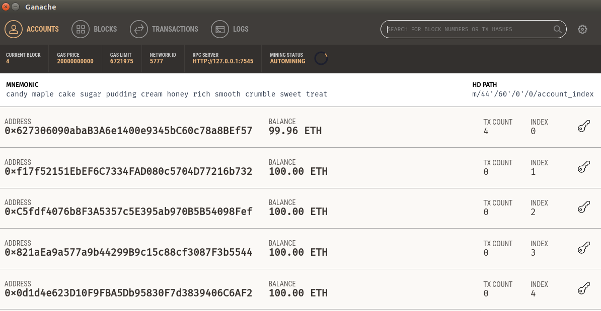
Ganache
Run a Local Ethereum Development Network

Slide 4

What is Ganache?
Ganache is part of the Truffle Suite
Quickly fire up a personal Ethereum blockchain environment
Ships with an internal JavaScript-based implementation of the Ethereum blockchain
Visual mnemonic & account info
See the current status of all accounts

Slide 5
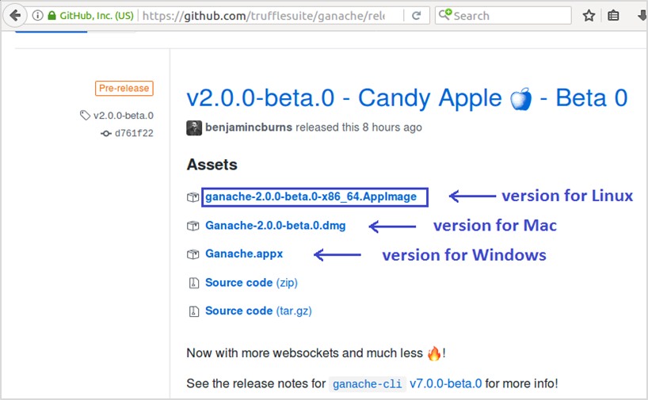
Installing Ganache
https://github.com/trufflesuite/ganache/releases

Slide 6
Ganache – Accounts

Slide 7
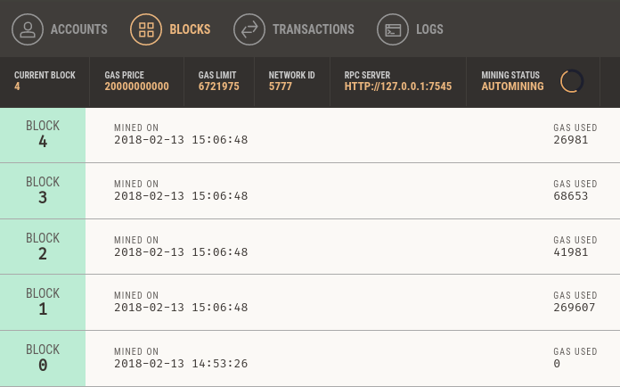
Ganache – Block Explorer
Log output of Ganache’s internal blockchain
Responses and other vital debugging information

Slide 8
Ganache CLI (Command-Line)
Command-line Ethereum environment (formerly called TestRPC)
Run ganache-cli as docker image
Install ganache-cli as local Node.js package
Run ganache-cli from the console:
docker run -it -p 8545:8545 trufflesuite/ganache-cli
npm install –g ganache-cli
ganache-cli

Slide 9
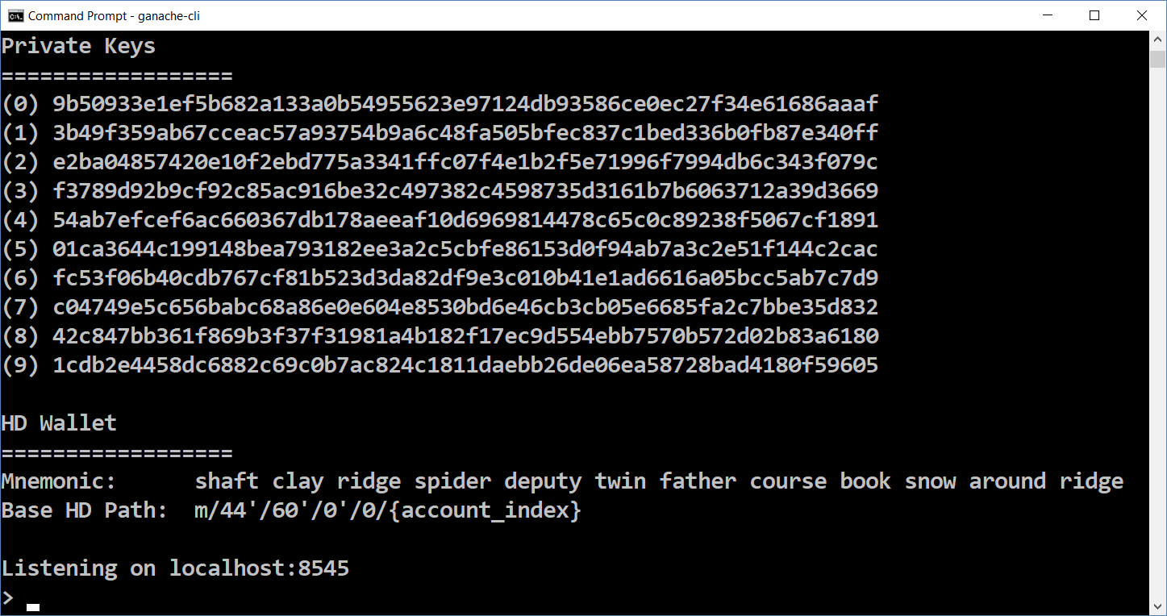
Ganache CLI (Command-Line)

Slide 10
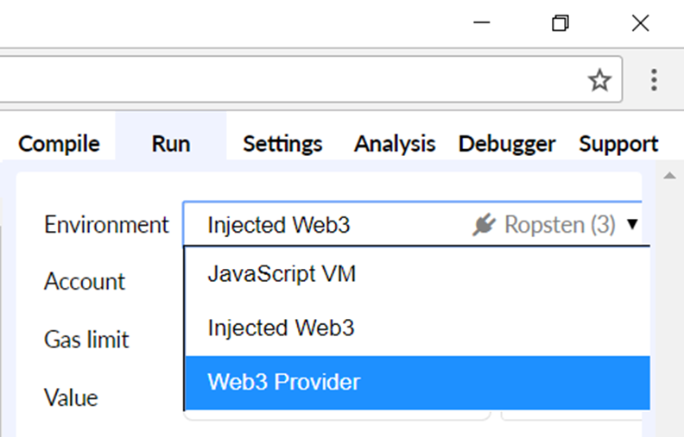
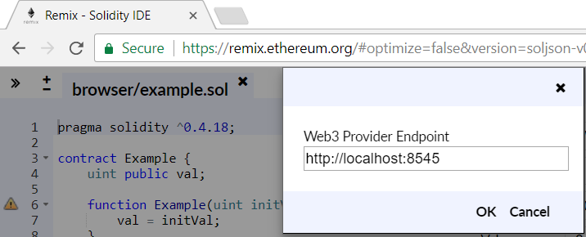
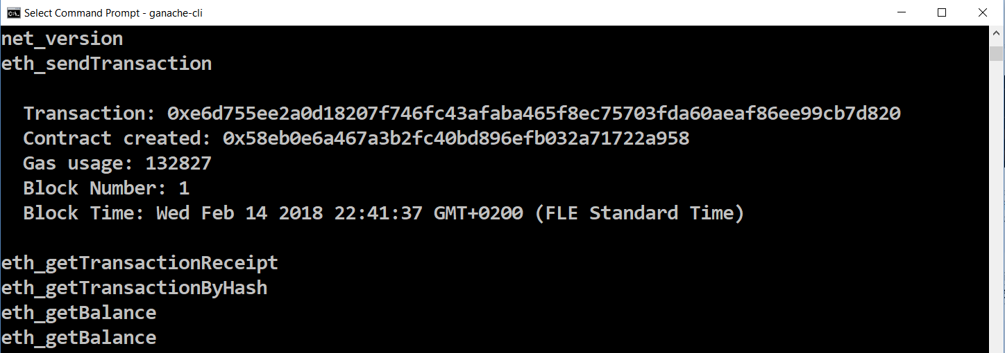
Connecting from Remix IDE to Ganache

Slide 11

Truffle Framework
Development Environment, Testing Framework and Asset Pipeline for Ethereum

Slide 12
Truffle
Truffle provides tools for smart contract development
Compilation of contracts
Deployment of contracts
Interactive console
Local EVM environment
Unit testing for smart contracts
Scriptable, extensible deployment & migrations framework

Slide 13
Truffle
Network management for deploying to public & private networks
Package management with EthPM & NPM
Using the ERC190 standard
Interactive console for direct contract communication
Configurable build pipeline with support for tight integration
External script runner that executes scripts within a Truffle environment
Installing Truffle
npm install -g truffle

Slide 14
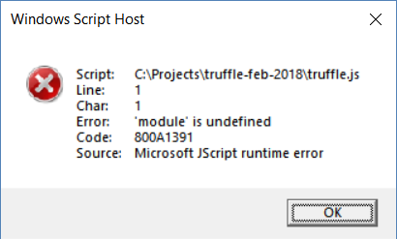
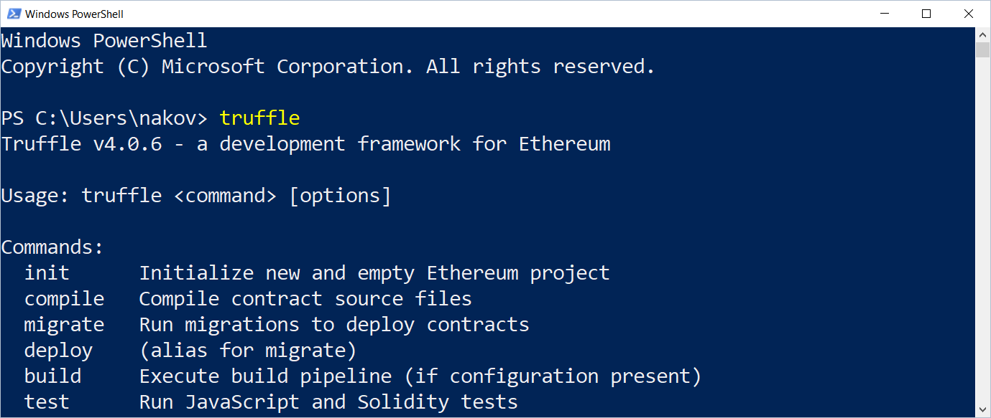
Running Truffle
Just type "truffle" at the console
In Windows use PowerShell, not the "Command Prompt"
Or you will get a JScript error

Slide 15
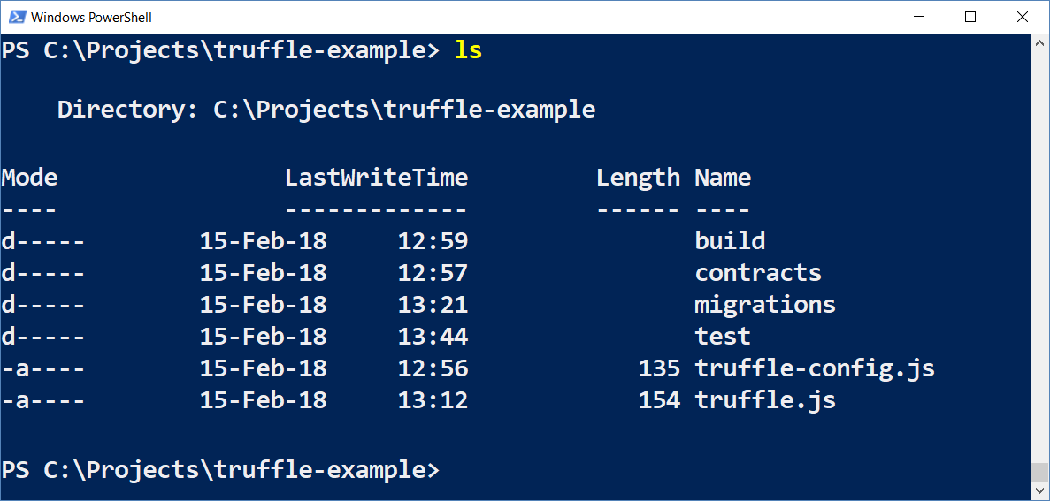
Truffle: Creating a New Empty App
mkdir truffle-example
cd truffle-example
truffle init

Slide 16
Truffle: Adding Contracts (Solidity Code)
Put your Solidity code in your project's contracts/ directory
contracts/SimpleStorage.sol
pragma solidity ^0.4.18;
contract SimpleStorage {
uint private storedData;
function set(uint x) public { storedData = x; }
function get() view public returns (uint) {
return storedData;
}
}

Slide 17
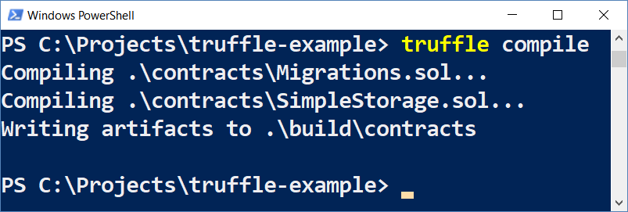
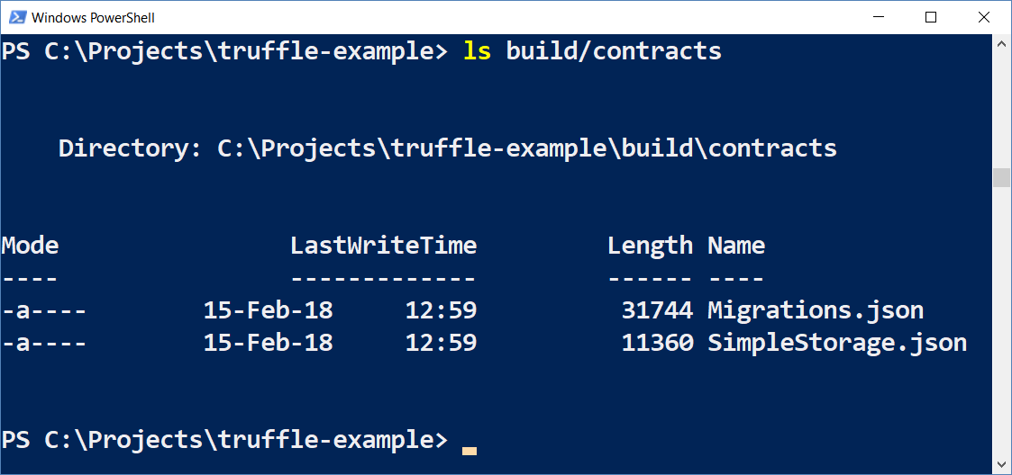
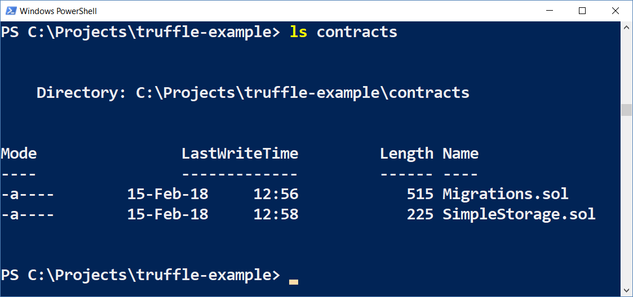
Truffle: Compiling Contracts
Compile your Truffle project
The output is in build/contracts/{filename}.json
truffle compile

Slide 18
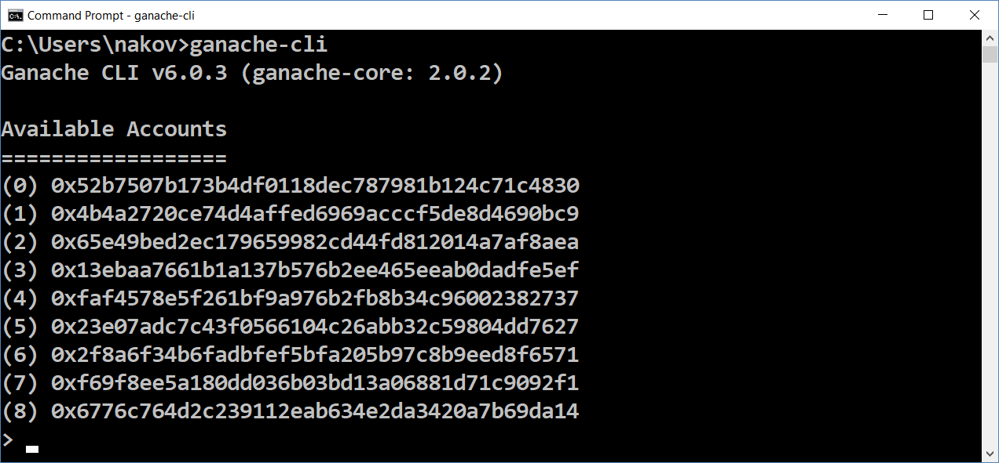
Truffle: Run Ganache or Ganache CLI

Slide 19
Truffle: Configure Networks
truffle.js
module.exports = {
networks: {
development: {
host: "127.0.0.1",
port: 8545,
network_id: "*" // Match any network id
}
}
};
Define your Ethereum networks and their RPC
Connect to your local Ganache RPC server

Slide 20
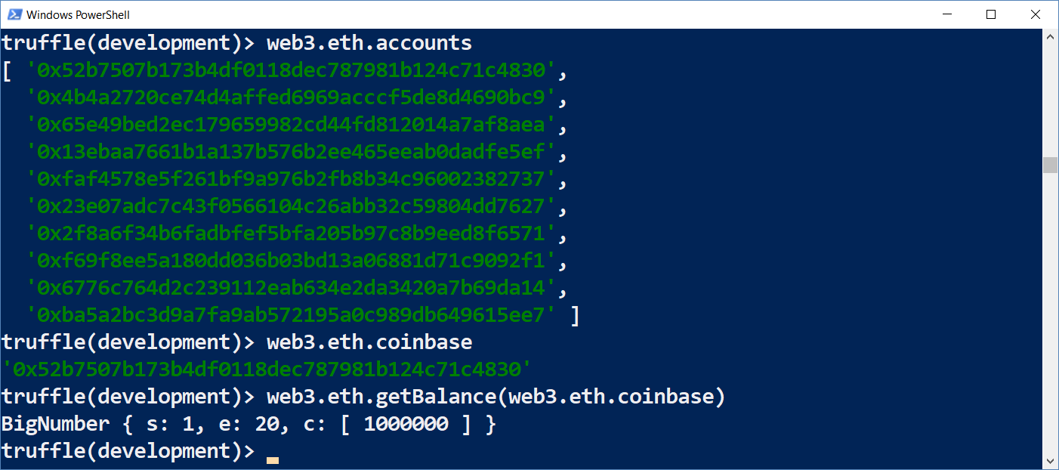
Truffle Dev Console
truffle console

Slide 21
Truffle Deployment: Migrate
First, add a new migration to deploy your new contracts:
Execute the migrations to get your contracts deployed:
migrations/2_simple_storage.js
var SimpleStorage = artifacts.require("SimpleStorage");
module.exports = function(deployer) {
deployer.deploy(SimpleStorage);
};
truffle migrate

Slide 22
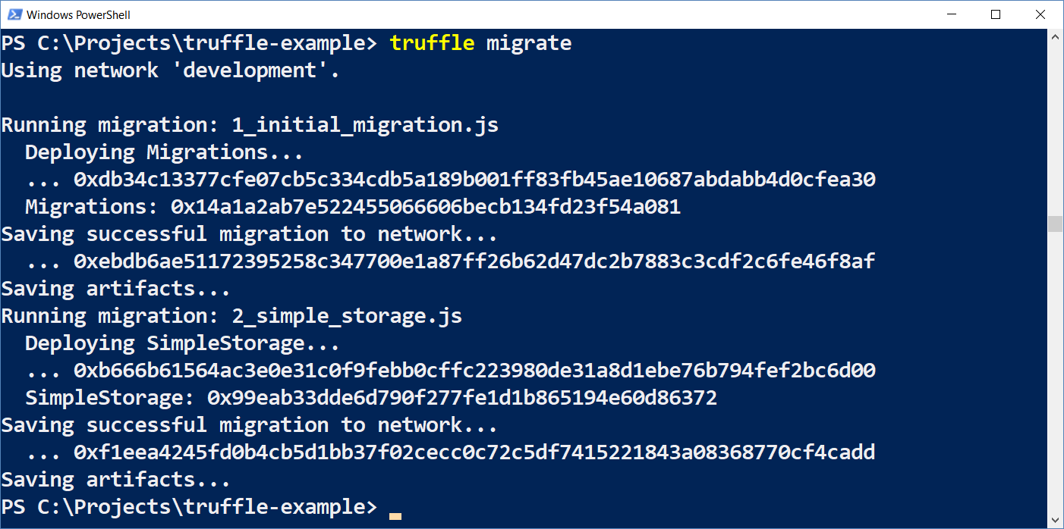
Truffle Deployment: Execute the Migrations

Slide 23
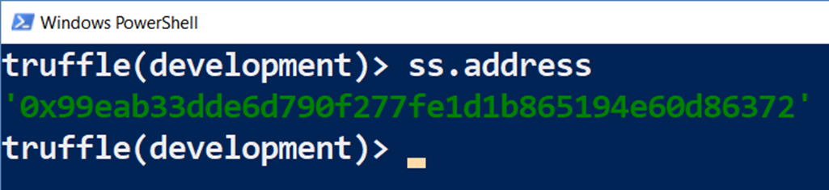
Interacting with the Deployed Contracts
Get an instance of the deployed contract
Inspect the contract instance:
let ss = SimpleStorage.deployed().then(instance => { ss = instance });
ss.address

Slide 24
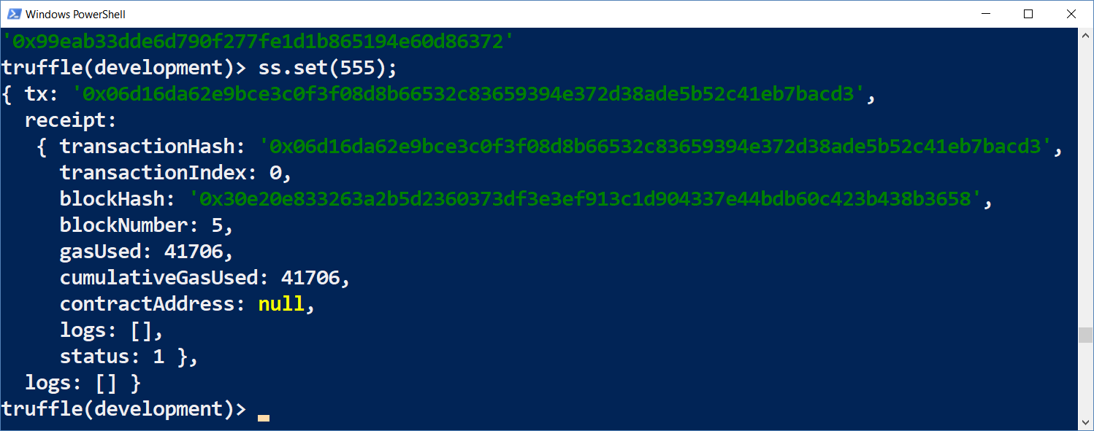
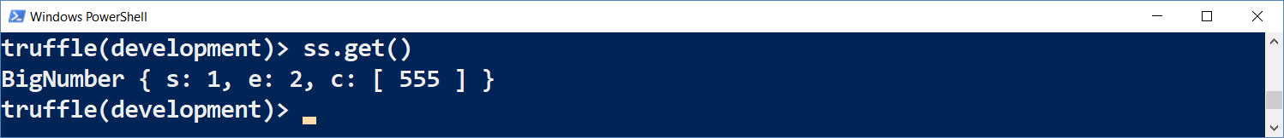
Invoking Contract's Functionality

Slide 25
Creating a New Contract Instance
Create a new instance of existing contract
Inspect the contract instance:
let newInst = SimpleStorage.new().then(instance => { newInst = instance });
newInst.address
newInst.transactionHash
newInst.get()
newInst.set(123);

Slide 26
Truffle: Unit Testing Smart Contracts
test/TestSimpleStorage.js
var SimpleStorage = artifacts.require("SimpleStorage");
contract('SimpleStorage', function(accounts) {
it("should deposit 1000", async function() {
let instance = await SimpleStorage.deployed();
await instance.set(1000);
let val = await instance.get();
assert.equal(val, 1000, "1000 should be set");
});
});

Slide 27
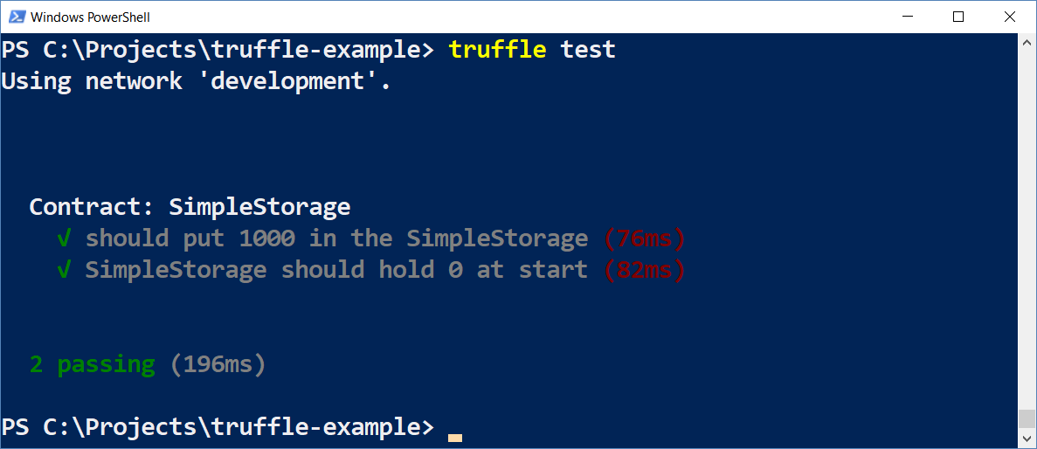
Truffle: Running the Tests

Slide 28

Exercise: Install Truffle and Ganache
Install
Development Environment and Framework

Slide 29

Summary
Ganache
Testing Ethereum environment for developers
Available as GUI and command-line
Truffle Framework
Framework and tools for Solidity development
Starter kits (boxes)
Compile, migrate, deploy, run, test Solidity code

Slide 30
Truffle and Ganache
http://www.kingsland.academy

Slide 31
Resources
Truffle Framework:
http://truffleframework.com
http://truffleframework.com/docs/
Ganache:
http://truffleframework.com/ganache/
http://truffleframework.com/docs/ganache/using

